Slide 1
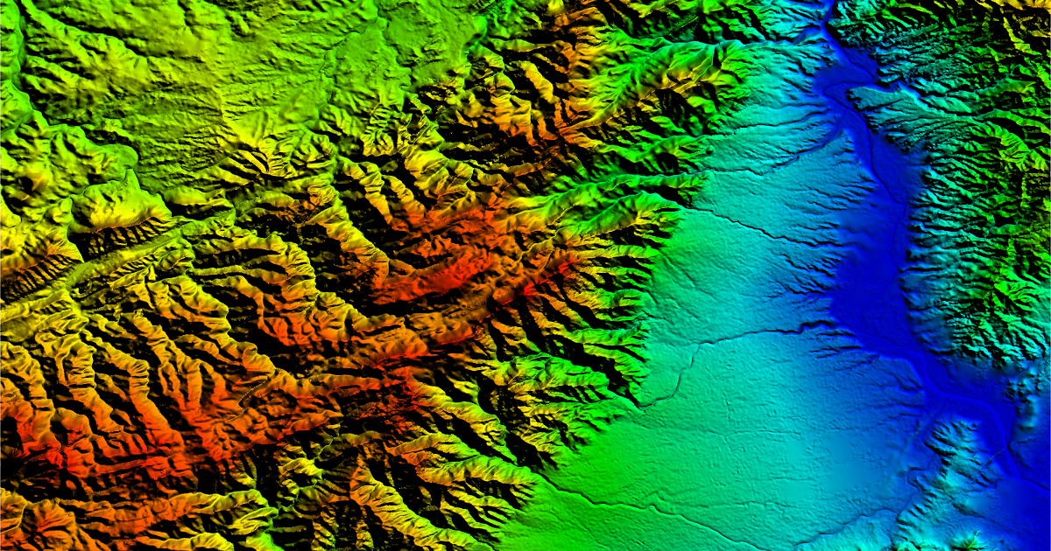
Analysing Digital Elevation Models Using Python by Extracting Data From Earth Explorer
=

Slide 2
The Flow
Introduction: Satellite
Photogrammetry & DEM
Applications and Future Scope
Brief Review of Literature
Extraction of Data From Earth Explorer
Python program for DEM Analysis of Nagpur

Slide 3
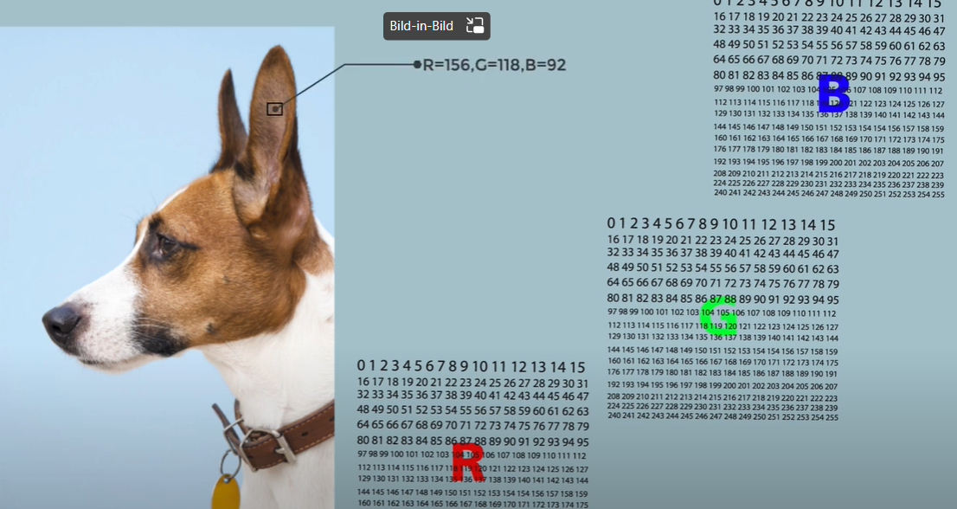
Introduction: Photogrammetry
- Measurements from photographs
- Shape, Depth & Volume
Feature selection , Matching,
Intersection, Densification.
- Uses multiple 2D images
- Creates a 3D image

Slide 4
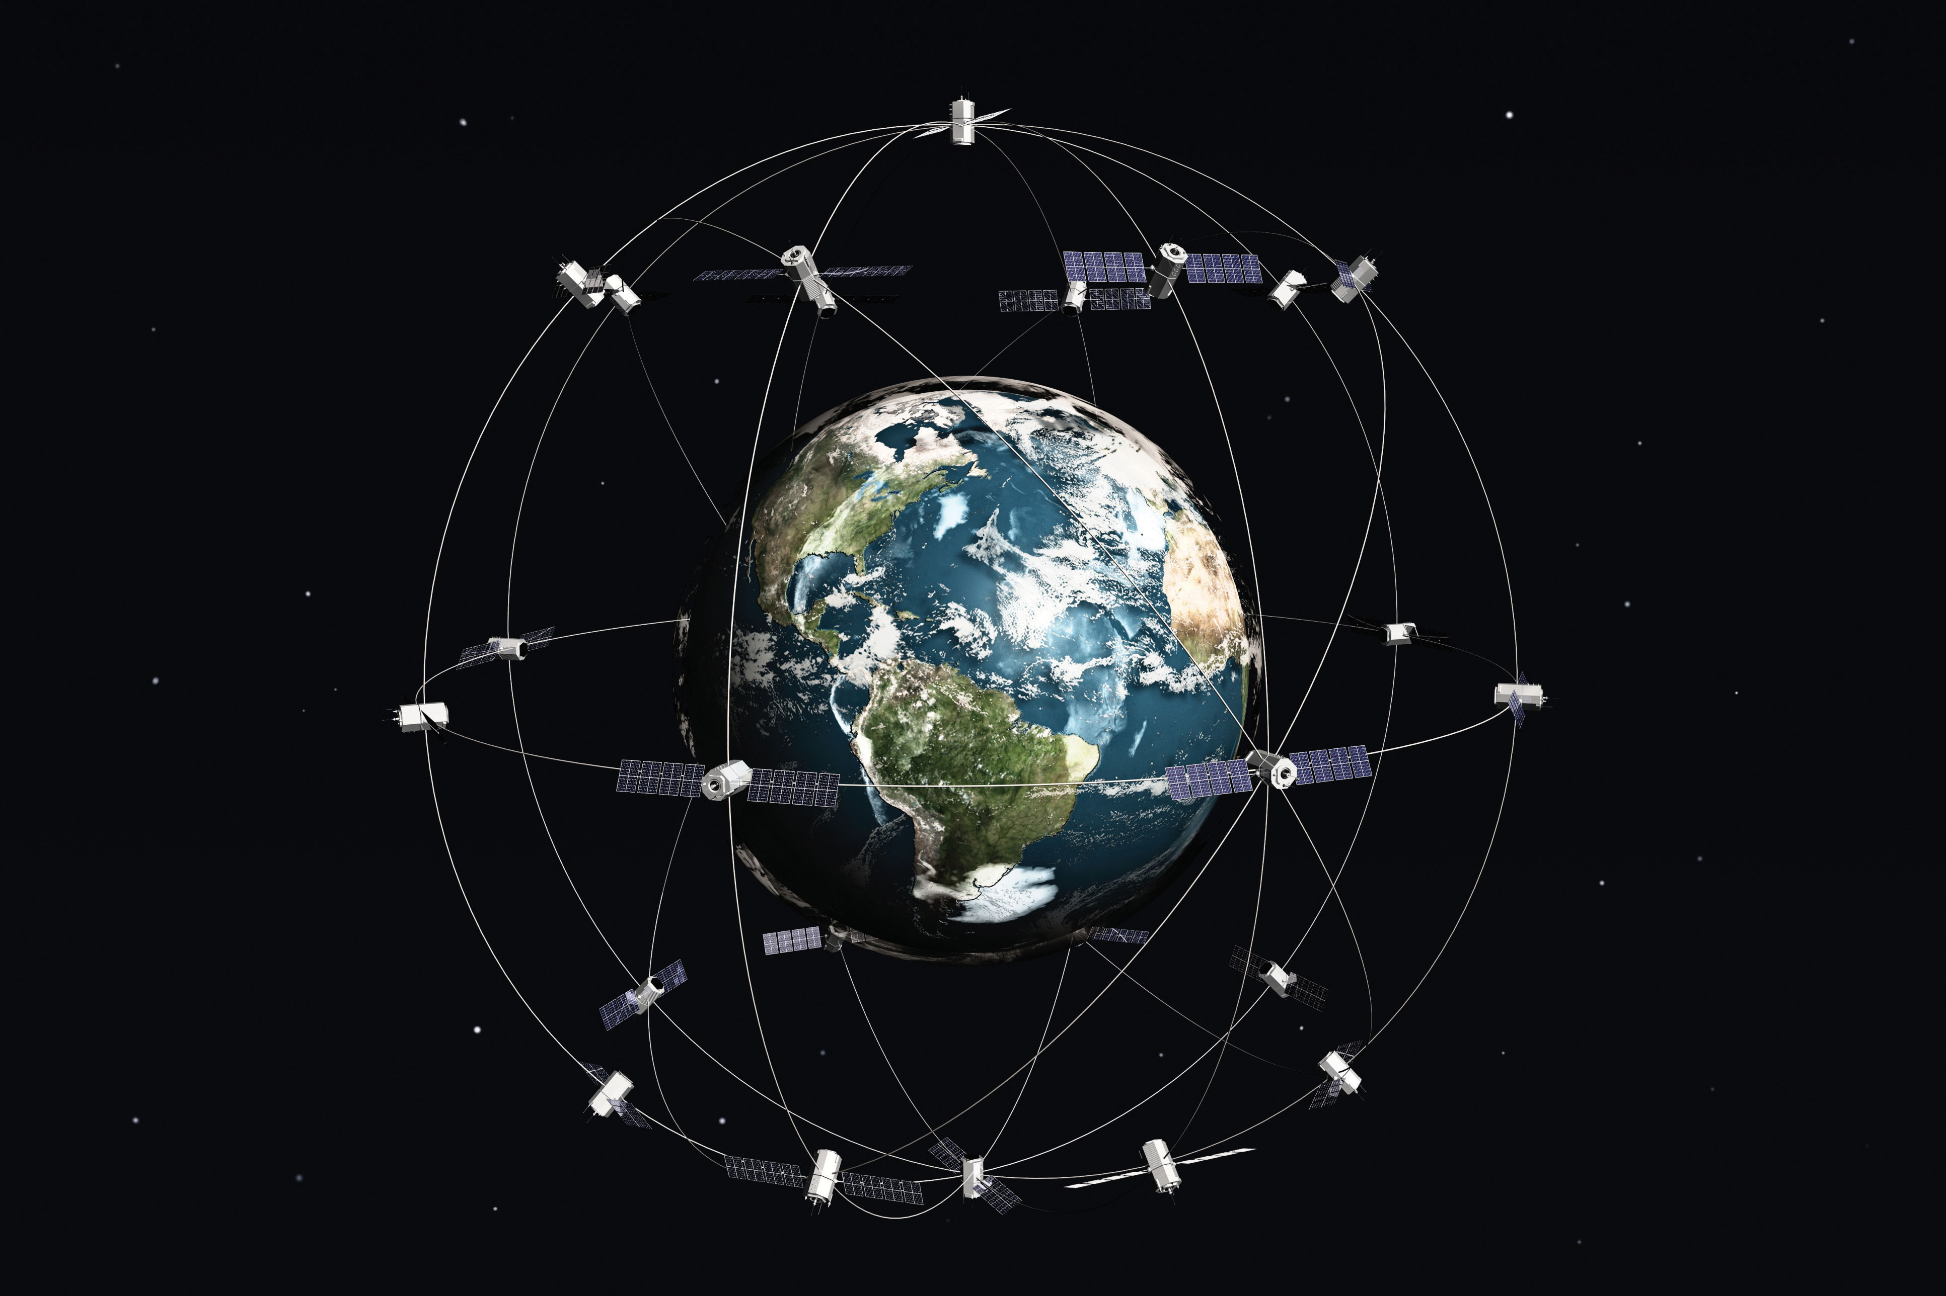
Introduction:
Satellite Photogrammetry and DEM
Large number of HQ images
From Satellite are merged
Digital Elevation Model
- File Format: TIFF

Slide 5
Brief Review of Literature
Shift to Deep Learning techniques (CNNs)
Data: SRTM and LIDAR
Interesting studies: (Nikolaidas, 2021), (Carney, 2019)
Knime
Rasterio and Richdem
The Literature Review Database

Slide 6
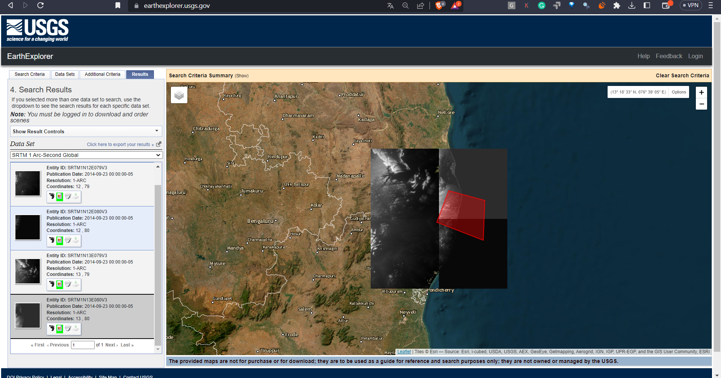
Extraction Of Data From Earth Explorer

Slide 7
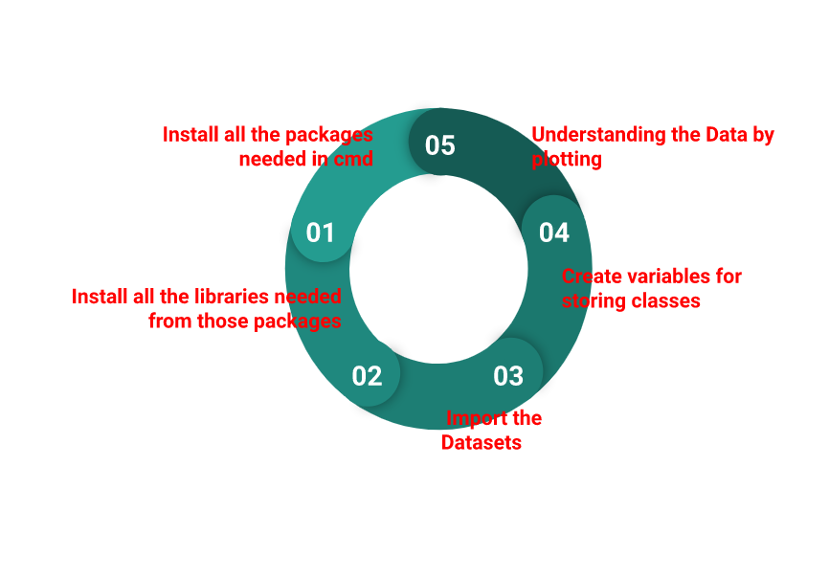
Python program for DEM Analysis of Nagpur

Slide 8
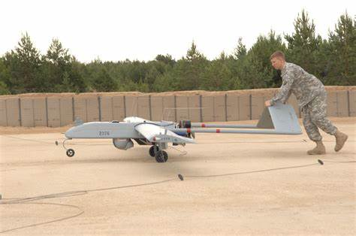
Applications & Future Scope
Navigation for UAVs(Unmanned Aerial Vehicles )
Hydrologic Modelling
Terrain Stability
- Use of Machine Learning and Deep Learning Techniques
Inclusion of color satellite images from Google maps(Nikolaidas, 2021 )
Addition of images from untraversed regions from a variety of sources (Carney, 2019)

Slide 9
Thank you!

